Slide 1
Analyzing Salary Growth Patterns Based on Work Experience
Dhatchanamoorthi N
March Dads 25
23/06/2025

Slide 2
Objective
The project focuses on uncovering trends and relationships between years of experience and salary levels by performing data cleaning, aggregation, and visualization. SQL was used to query and segment the data, while Excel enabled effective data visualization through charts and pivot tables to support insight-driven conclusions.

Slide 3
Data Cleaning and Pre-processing
Size,
Key columns,
Source,
Handling missing values,
Standardizing,
Adding outliers,

Slide 4
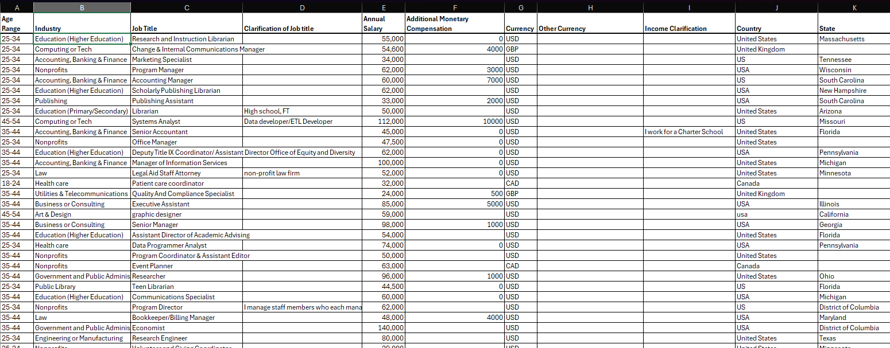
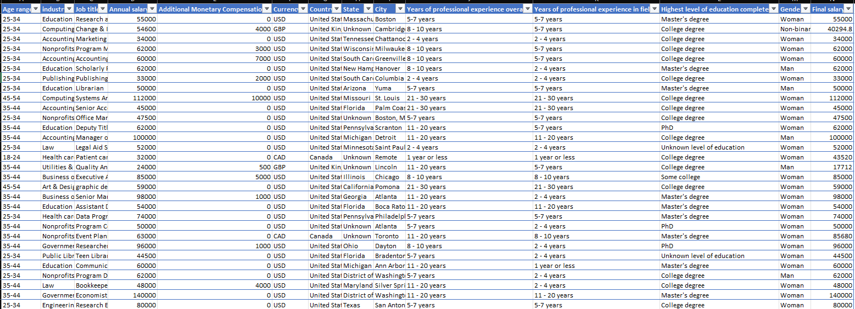
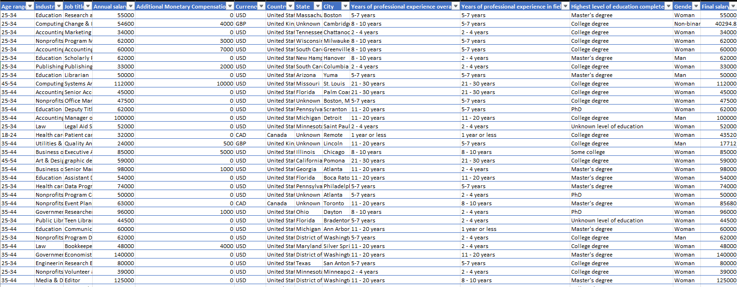

Conversion of raw data to cleaned data

Slide 5
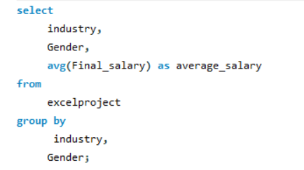
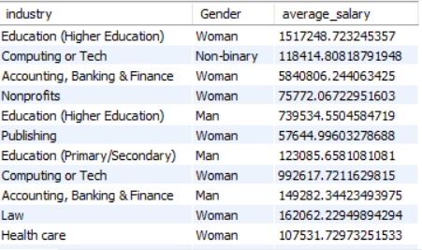
SQL Queries
1,Average Salary by Industry and Gender

Slide 6
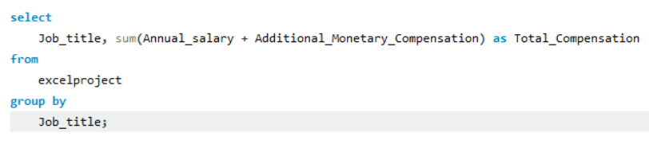
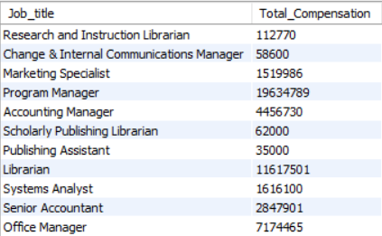
2. Total salary compensation by job title

Slide 7
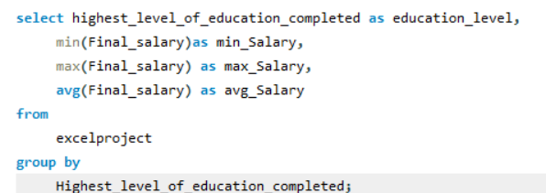
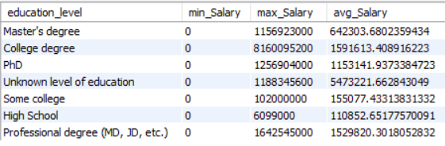
3. Salary distribution by education level

Slide 8
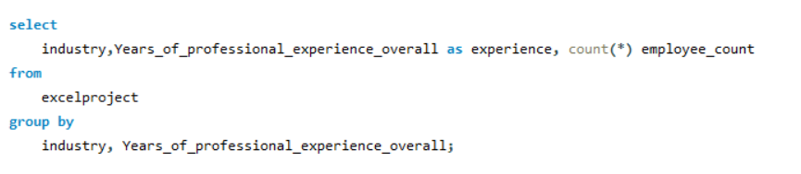
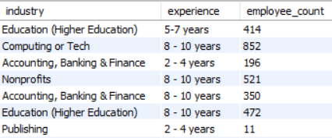
4. Number of employees by industry and years of experience

Slide 9
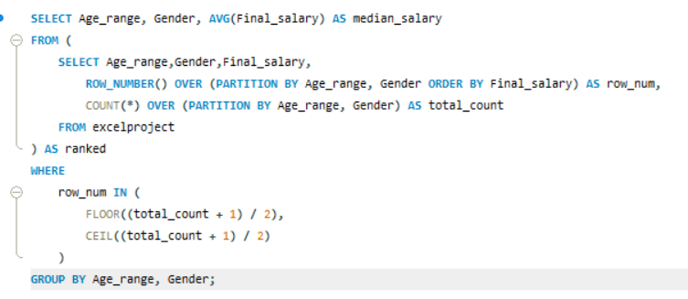
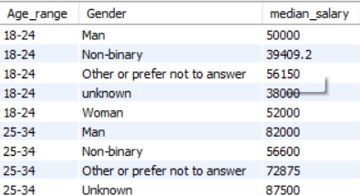
5. Median salary by age range and gender

Slide 10
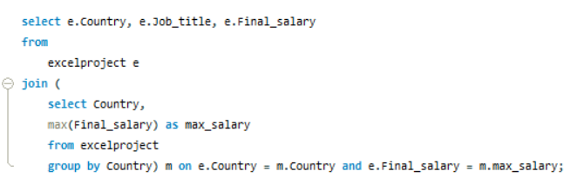
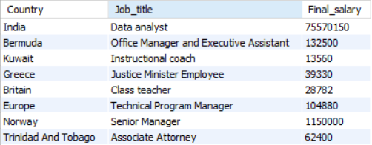
6.Job titles with the highest salary in each country

Slide 11
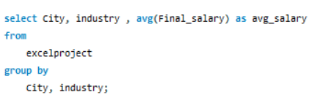
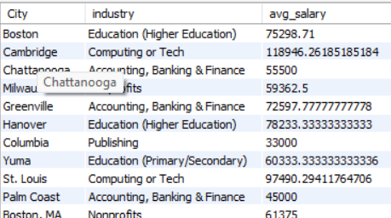
7.Average salary by city and industry

Slide 12
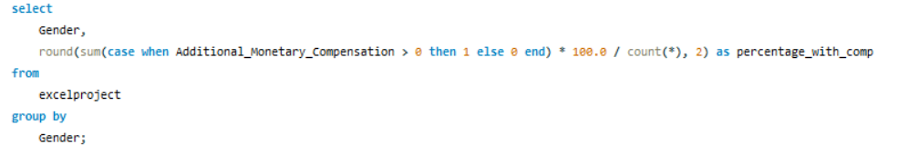
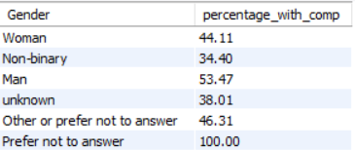
8.Percentage of employees with additional monetary compensation by gender

Slide 13
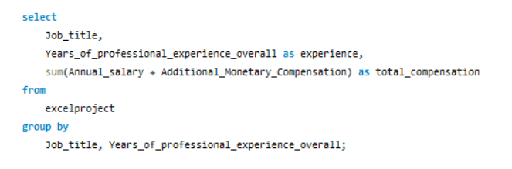
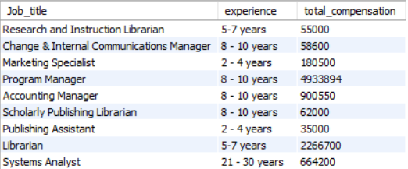
9.Total compensation by job title and years of experience

Slide 14
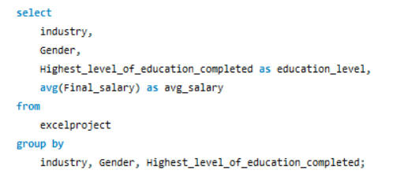
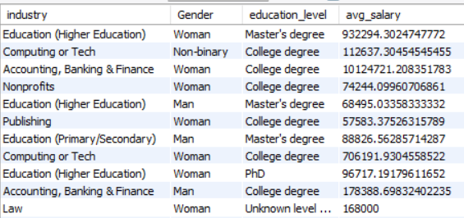
10.Average salary by industry, gender, and education level

Slide 15
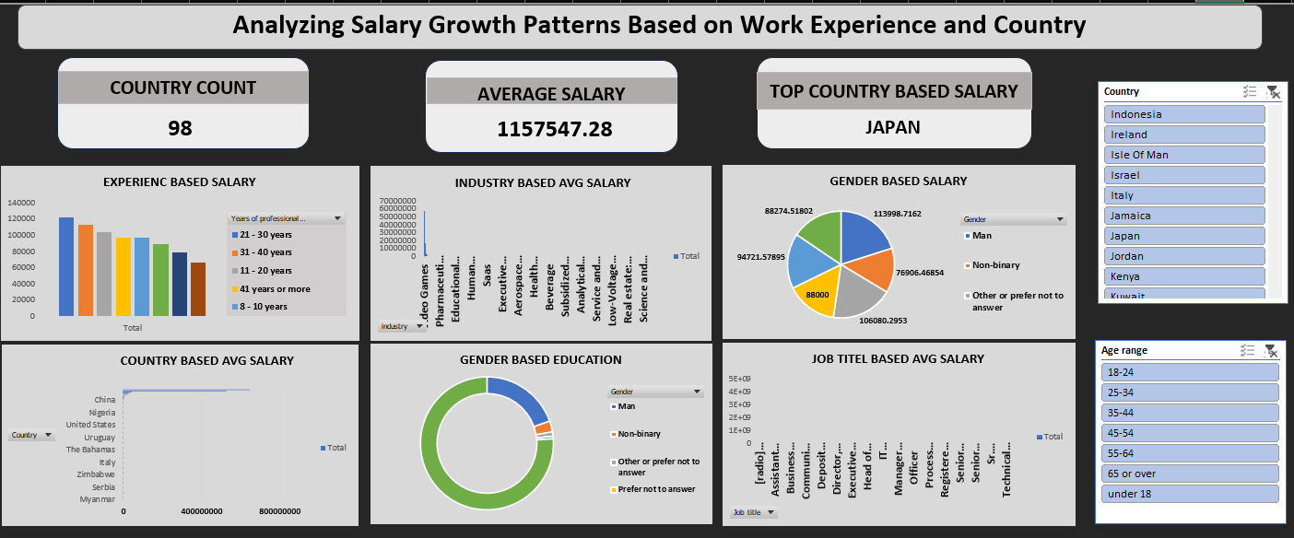
DASHBOARD OVERVIEW

Slide 16
Insights & Trends
High-paying industries The technology and finance sectors consistently offer top-tier compensation, driven by high demand for specialized skills and digital transformation initiatives.
Evolving gender pay dynamics In select industries (e.g., Healthcare, Education, and Technology), female professionals are earning more on average than their male counterparts,
Top-compensated job roles Positions such as Engineering Manager, Product Manager, and Data Scientist not only command high base salaries but also receive substantial bonuses and equity,
Remote work & compensation Employees in remote roles are earning comparable or even higher salaries than on-site peers, indicating that remote flexibility does not hinder pay

Slide 17
Conclusion
Implement equitable salary structures
Align HR policies with evolving workforce expectations
Benchmark salaries to remain competitive across roles and sectors
Promote employee satisfaction and retention
Strengthen diversity, equity, and inclusion (DEI) initiatives

Slide 18


